Slide 1
Chapter 16
Creating a Sliding Menu in React

Slide 2
Objectives
How the Sliding Menu Works
Setting Up the Sliding Menu
Getting Started
Showing and Hiding the Menu
Creating the Button
Creating the Menu

Slide 3
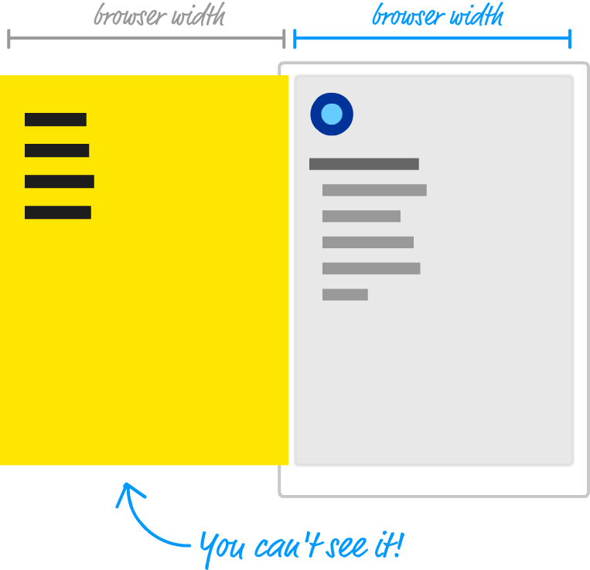

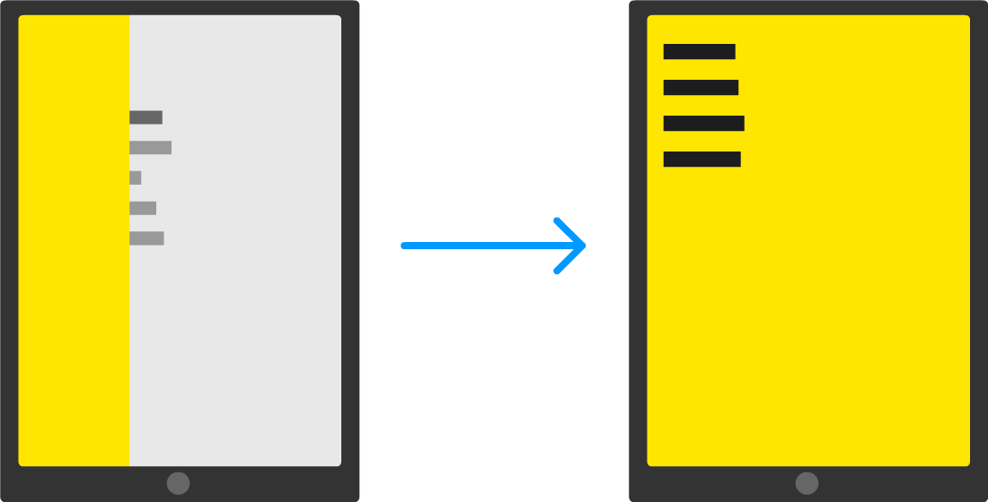
How the Sliding Menu Works
Before we jump into the code, let's take a few moments to better understand how exactly our sliding menu works. Starting at the very top, we have our page that displays some content:

Slide 4
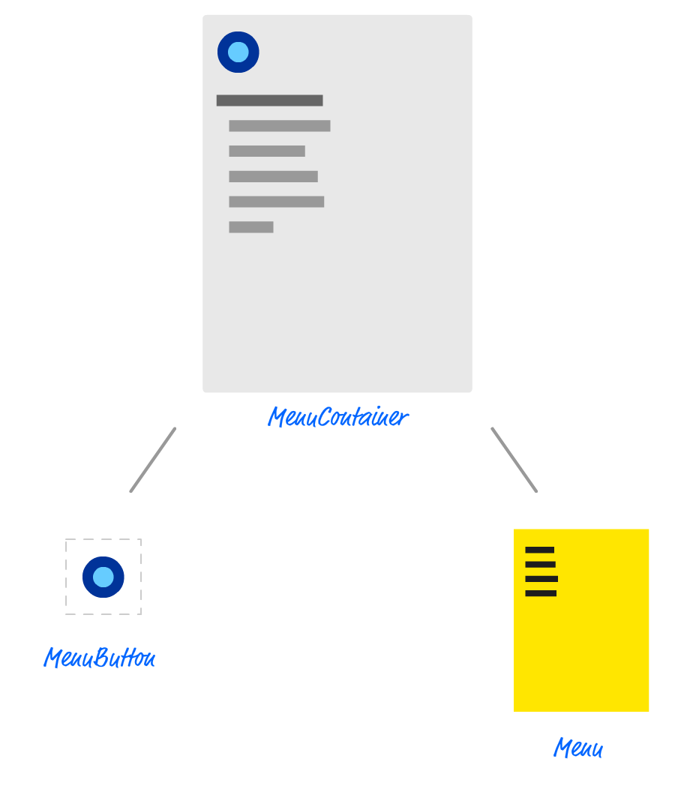
Setting Up the Sliding Menu
This component is responsible for doing non-visual things like managing state, hosting our Menu & MenuButton components, and displaying some of the initial text. The birds eye view would look a bit like this:

Slide 5
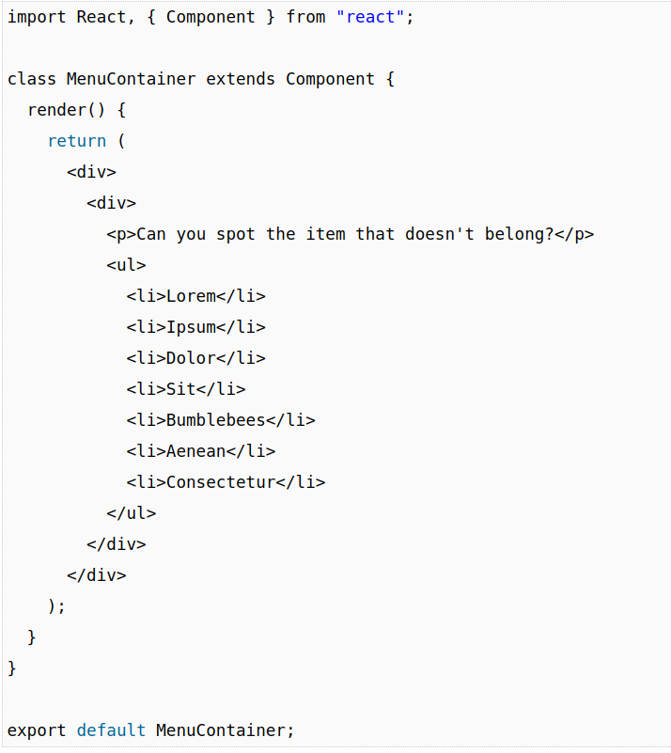
Getting Started
There isn't much to say about these style rules, so the last thing we will do for getting our initial app setup is create our MenuContainer component. Create a file called MenuContainer.js in the src folder and add the following JS and JSX into it:

Slide 6
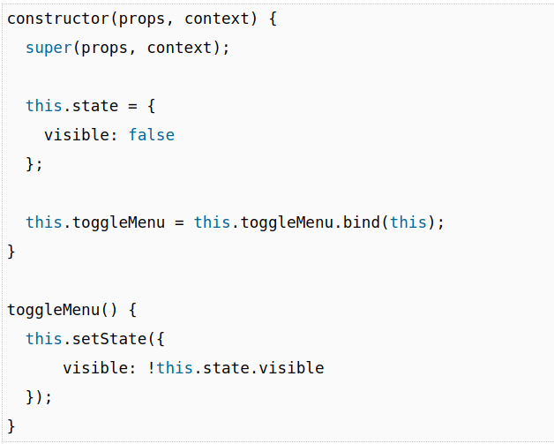
Showing and Hiding the Menu
With the initial setup out of the way, it's time for the fun part: actually building the menu! The way our menu is shown or hidden is as follows:
When you click on a button, the menu slides into view
When you click anywhere on the menu, the menu slides out of view

Slide 7
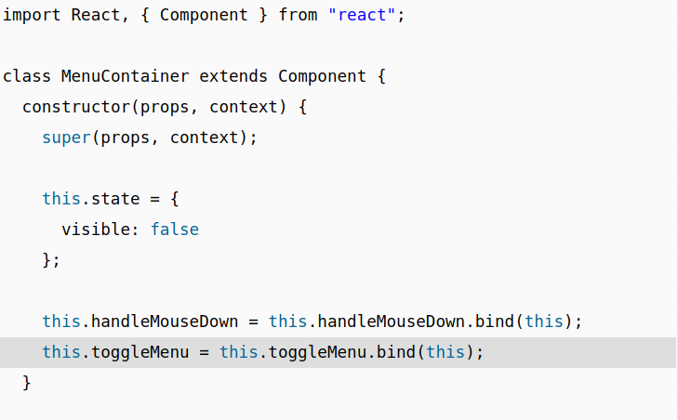
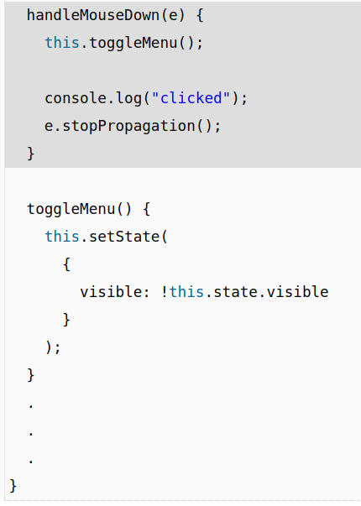
Showing and Hiding the Menu

Slide 8
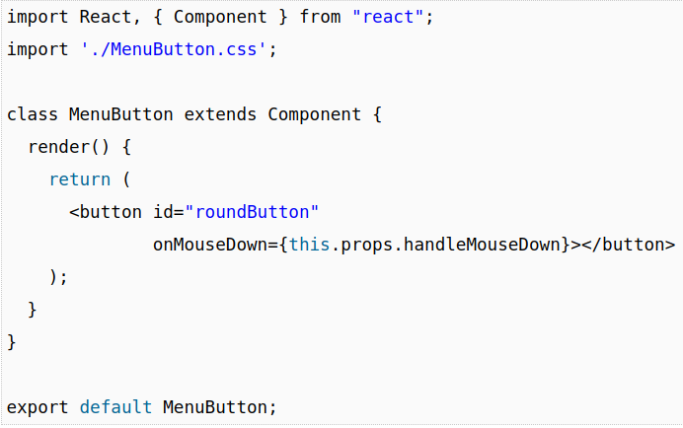
Creating the Button
In your src folder, create two files called MenuButton.js and MenuButton.css. Once you've created both of these files, open MenuButton.js in your code editor. Inside it, add the following lines of code:

Slide 9
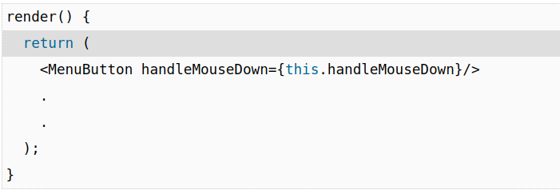
Creating the Button
Once you've made this change, it is time to actually instantiate our newly created MenuButton component. Go back to the MenuContainer component and add the following highlighted line inside the rendermethod:

Slide 10
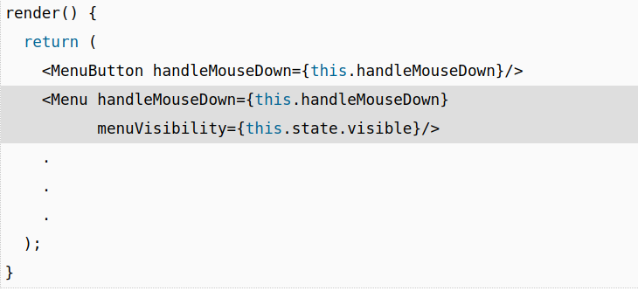
Creating the Menu
It is time to create our Menu component that will be responsible for all things dealing with the menu! Before we actually create this component, let's first pretend it already exists and call it from our render method inside our MenuContainer. Add the following highlighted call to our (currently imaginary) Menu component just below where you added the call to MenuButton a few short moments earlier:

Slide 11
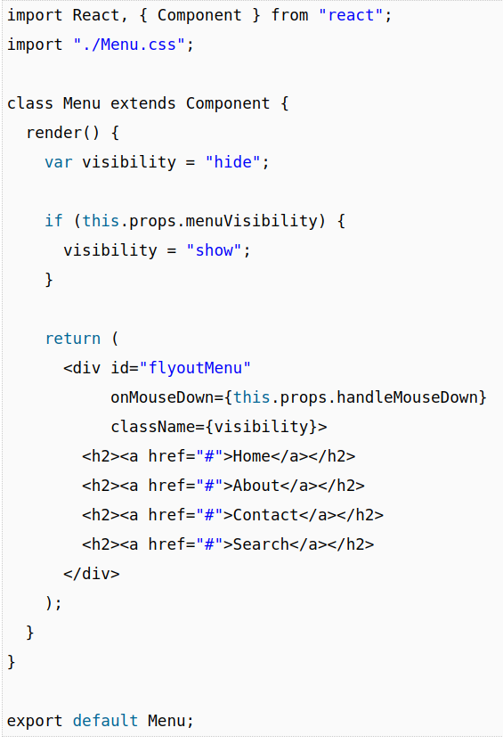
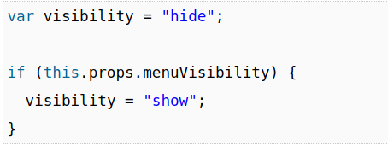
Creating the Menu
In the same src folder we have been partying in for the past few sections, add one file called Menu.js and add another file called Menu.css. Inside Menu.js, add the following contents
Getting back to our code, the value of visibility is set a few lines earlier:

Slide 12
Conclusion
This is one of the first examples we've looked at where we are using React to create something that is a common UI occurence - a sliding menu.
As part of this, we learned more about the interplay between components such dealing with events/event handlers, sharing state, and so on.
As we look at more examples together, you'll see that there isn't a whole lot more to React than what we've seen here.
All that remains is just a clever arrangement and re-arrangement of the same concepts in more complex scenarios.
This doesn't mean we are done, though. There is more React to be had and more examples to create and fully understand!

